Slide 1
BestBytes
Team:
Walter Xia
Ryan Fuller
Eric Kramer
Abderrahman Said-Alaoui
Santiago Munevar

Slide 2
What is it?
A trump meme generator??!

Slide 3


Slide 4
Website and Database
Well since someone took Music immediately...
Topic: News
Pillars: Articles, Sources, Locations

Slide 5
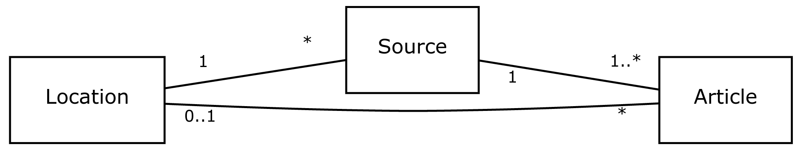
UML

Slide 6
Pillars attributes

Slide 7
API

